Slide 1


Slide 2


Managers’ Network Meeting Recruitment
Square Pegs – Round Holes
26th June 2019

Slide 3

WELCOME & HOUSEKEEPING
Fire alarms
Toilets
Mobile phones
Photographs
Evaluations

Slide 4
Introductions:
Your name
Your organisation
Your type of service
The key thing you would like to get out of today?
Why
Notes:
Your networking event so I would like to get an idea of what you are all here for and which of these are a priority for you. This will help to allocate our time this morning effectively.
Make a note of additional outcomes required

Slide 5
Key Outcomes:
How to:
  Develop a successful recruitment process
  Access recruitment and Selection Resources
  Access practical recruitment support
  Make the best use of social media
  Create a supportive working environment
Future recruitment learning opportunities
Sharing best practice
News and Updates

Slide 6
Recruitment and Selection Process
Write Job Description
Confirm selection criteria
Advertise
Interview and select
Support Supervise and Develop
Assess Vacancy

Slide 7
Recruitment in your Care Setting
As a table discuss:
What is good about your current process?
What could be improved?
Notes:
Feedback from each of the tables as to what the key success factors are in each of these?

Slide 8

Recruitment and Selection Process
Church Farm Care took part in Care2Change project, funded by OPTIMUM, with a focus particularly around the recruitment process.
The issues were:
The order the recruitment process took
Whether the steps in the process were correct.
The timeframe of the process.
Who was involved?
Effectiveness of hours spent.

Slide 9
Recruitment and Selection Process
Following the project the recruitment process was overhauled:
Appropriate staff identified for the tasks involved.
An introduction of a sit and see period before the actual interview takes place.
Introduction of electronic DBS check.
The order of the process tweaked.
Time spent on the process reduced.

Slide 10
Recruitment and Selection Process
In summary the new process has meant that:
only staff who want to work with us get interviewed,
they get to sit and see the environment first,
their induction is planned following successful interview,
references and DBS processing are started immediately the job is accepted,
they get to start work sooner as the process is efficient.
Liz Norton: Training, Learning and Development Manager

Slide 11

Recruitment Resources
https://www.nottinghamshire.gov.uk/owl/business
Notes:
You may have more – please let me know
Flip chart to capture other websites or information

Slide 12

Skills for Care Resources
Values Based Recruitment and other resources
Lucy McDonald
Locality Manager
Skills for Care

Slide 13


The Nottingham Jobs Service:
Supporting residents into work and enabling employers to access a skilled workforce.

Slide 14
Who we are and what we do:
A partnership between Nottingham City Council, the Department for Work & Pensions and the Futures Group.
A publicly-funded employment & skills service, free at the point of use, supporting both employers and jobseekers in the Greater Nottingham area.
We provide:
  Tailored recruitment support and job advertising
  Access to an extensive candidate base through our partnership
  Grants to support salary costs and staff training
  Advice and help to take-on apprenticeships
  Assistance to access the right training for your organisation
  Guidance on becoming recognised as a top-quality and inclusive employer

Slide 15
Recruitment Support:
As much or as little support as you need:
  Spaces for interviewing, open days, testing
  Applicant sifting
  Advertising and promotion via our website, social media and bulletins
Different recruitment methods:
  Open days
  Sector based work academies
  Work experience
  Work trials
  Jobs fairs

Slide 16
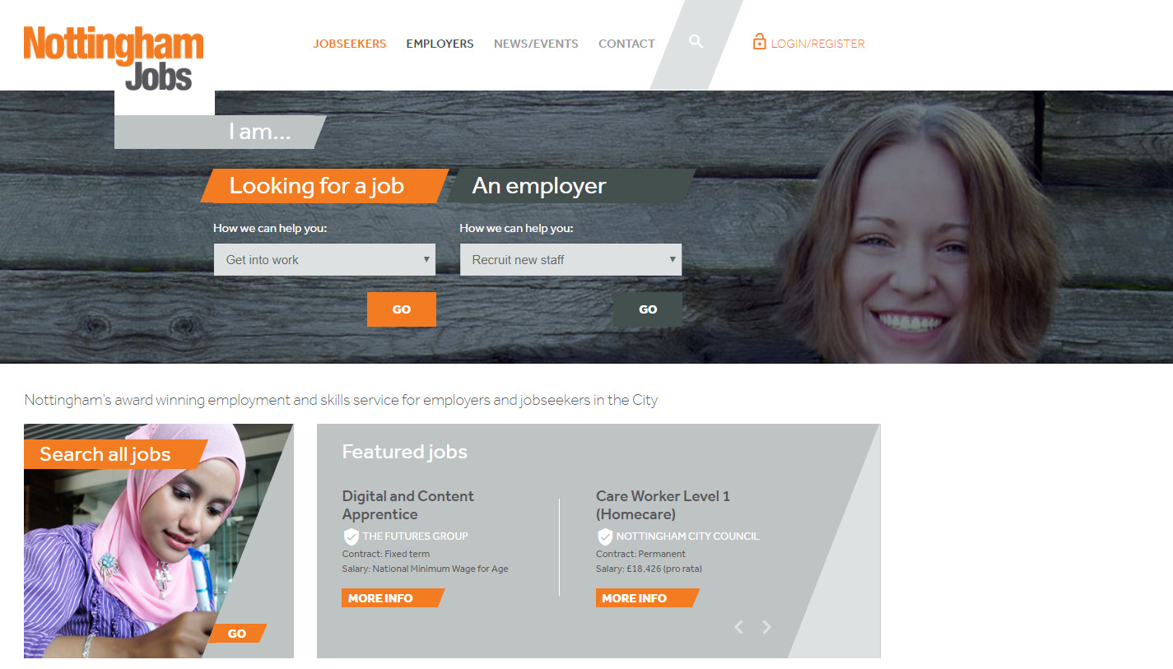
Candidate Pool:
DWP systems
Nottingham City Council
Futures’ services and programmes
Nottingham Jobs registration and bulletin service
Notes:
DWP systems – employment support for all out-of-work benefit claimants and increasingly universal credit claimants (including in-work)
Nottingham City Council – public campaigns (bins, bus shelters, buses, lamppost banners) plus a variety of community organisations working with jobseekers and local residents
Futures’ services and programmes – National Careers Service, Nottingham & Nottinghamshire Schools services, Employment and Adult Education programmes
Nottingham Jobs registration and bulletin service – over 2,000 individuals currently signed up for our bulletin

Slide 17
Grant Funding:
Nottingham Jobs Fund:
  Available for all employers until December 2019 (possible extension)
  £5000 per eligible candidate appointed (no maximum number of grants)
  Employers must take on unemployed or economically inactive city residents
  Role must be full-time and last for a year (although candidates can request part-time)
  Candidate must ideally be one of:
    BAME
    Lone Parent
    Over 50
    No basic skills (equivalent of C at Maths / English GCSE)
    Have a disability or health condition

Slide 18
Grant Funding:
Stay Ahead Grant:
  Available for SMEs (less than 250 employees, not a subsidiary) until September 2019
  £2,500 per organisation to fund training for existing staff
  Can be no more than 40% of the total cost of training
  Training for staff from the above categories encouraged
  Includes free skills assessment and matching to the right training provider

Slide 19
How to maximise applications in the Care Sector:
One in five 20 - 55 year olds have considered a job in adult social care but only one in every twenty-five of those go on to apply for a role.
1. How can we encourage more people to apply?
  Limit the number of “must have” requirements on your job advert
  Be clear about the locations you cover and what working patterns are available
  Use case studies
  Attract a more diverse talent pool by removing unconscious bias in job adverts: http://gender-decoder.katmatfield.com/
Notes:
Limit the number of “Must have” requirements on your job advert – 80% of people who work in care are women and one HP study showed that men apply for a job if they meet 60% of the qualifications, but women only apply if they meet 100% of them.
Be clear about the locations you cover and what working patterns are available – 64% of Mothers are still the primary carers for children according to research by Direct Line so offering flexible working is important to attract applicants.
Use Case Studies – e.g. on Facebook – use real Care Workers – local angles are key – use someone with a well-developed social media network e.g. NCC – HomeCare worker video on FB.
Attract a more diverse talent pool by removing unconscious bias in job adverts:
http://gender-decoder.katmatfield.com/
Without realising it, we all use language that is subtly ‘gender-coded’. Society has certain expectations of what men and women are like, and how they differ, and this seeps into the language we use. Think about “bossy” and “feisty”: we almost never use these words to describe men.
This linguistic gender-coding shows up in job adverts as well, and research has shown that it puts men off applying for jobs that are advertised with feminine-coded language.
This tool is a quick way to check whether a job advert has the kind of subtle linguistic gender-coding that has this discouraging effect.
Examples of female coded words include: compassion, enthusiastic, kind, loyal

Slide 20

How to maximise applications in the Care Sector:
2. How can we ensure that potential candidates complete the application process?
  Create the shortest application path possible
  Pick up the phone
3. How can we minimise the number of no-shows at interview?
  Test their commitment
  Text them a reminder of the interview
Notes:
Create the shortest application path possible – remove the application form as the first step and get them to register their interest initially.
Pick up the phone – speaking to an employer during the search process more than doubles the chance of an applicant completing the process. (Dept of Health and Social Care)
How can we minimise the number of no-shows at interview?
Test their commitment - Give them an interview date and then ask them to call to book their interview slot – those that do call are much more likely to attend an interview.
Text them a reminder of the interview - 99% of candidates who receive your text reminder will open this, in comparison to email reminders, with a much lower open rate.

Slide 21
Referral Schemes:
From 100 applications, one person was in the role after 6 months
but from 3 referrals, two people were in the role after 6 months.
  Make it visual when you pay it
  Average referral is £250
  Pay the referral fee earlier
  Keep a track of where your successful applicants come from and focus your efforts on that source
Notes:
From 100 applications, 1 person was in the role after 6 months but from 3 referrals, 2 were in the role after 6 months.
Make it visual when you pay it – not just in someone’s pay packet, promote the referral and payment across the business
Average referral is £250 – use NJF to fund
Pay the referral fee earlier – don’t wait till after probation – when referral fee was paid in first week of them joining, all were still there after 6 months.
Keep a track of where your successful applicants come from and focus your efforts on that source – you might get lots of applicants from Indeed but how many turn up to interview let alone start in the job?

Slide 22
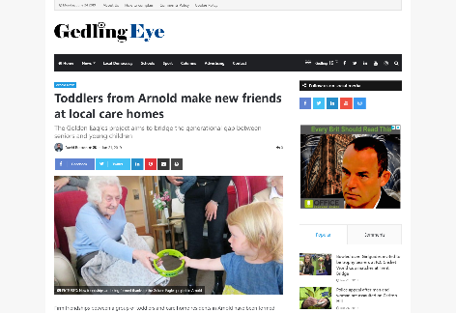
Making the best use of Social Media for recruitment:
  Boost your brand and people’s awareness of you as an organisation and it will naturally increase the number of applicants for your roles.
  Engage with people
  Interesting content or activities e.g. make videos using www.typito.com
  Check what other people are doing
  Scratch some backs
  Humanize your brand
  Virtual Jobs Fair
Notes:
Boost your brand and people’s awareness of you as an organisation and it will naturally increase the number of applicants for your roles.
Engage with people – talk with your audience, not to your audience - Interaction is one of the hallmarks of social media.
Respond to comments - Take the time to listen, engage and respond.
If a customer called you on the phone, emailed you, or walked up to your sales counter to ask a question or make a comment – what is the likelihood that you or another employee would simply ignore them? When a customer or prospect takes the time to address you online – they should be treated no differently.
Interesting content or activities that can pull them in to engage with your employer brand and job opportunities. E.g. Create your own videos: using free software such as: https://typito.com/home
Check what others are doing – e.g. Golden Eagles Project : Toddlers playgroup in Arnold care homes including Coppice Lodge Care Home, The Manor Residential Home, Boogie and Buffet for Care Home residents at Pryzm nightclub, Pony Interaction in Care homes (Pony Magic Nottingham)
Scratch some backs – be active – post frequently and consistently – respond to other posts within your sector.
Humanizing your brand is a necessary step to ensure your company’s success with a social media marketing strategy. E.g. Winter Care Campaign: #PhoneFiona on Twitter and Facebook
Virtual Jobs Fair – use your Facebook page to host a monthly Virtual Jobs Fair. Promote it on Twitter, FB.
Recruiters chat live with candidates using Facebook Messenger during the allotted time frame, answering questions and doing a bit of a pre-screen.
It can be hard to get off work to attend a job fair. But anyone can attend a virtual career fair – from anywhere, using their mobile device and the Facebook Messenger app! People can jump in during their break, while commuting, whenever it works for them.
Another benefit is that these events are way more cost-effective than in-person events – and we get better turnout!
Beyond the boost in brand awareness, this adds a really positive element to the Candidate Experience. Facebook Messenger is such an easy, non-intimidating way to connect with a company for the first time to find out about their hiring process, company culture and your suitability for a role.

Slide 23

How can you implement a Social Media strategy?
  Offer the role as a development opportunity internally
  Access free courses e.g. https://www.d2n2growthhub.co.uk/events-workshops/2019/07/18/d2n2-growth-hub-digital-seminar/
  Utilise StayAhead and/or NJF grants to fund their training and development
Notes:
Offer the role as a development opportunity internally – find an existing staff member who is Social Media savvy and offer them the role as part of their CPD
Access free courses e.g. D2N2 Growth Hub Digital Seminar – Rushcliffe Arena, 18th July: From getting the most from your social media channels to making sure your business stands out from the crowd in online searches, these seminars will help businesses across Derby, Derbyshire, Nottingham and Nottinghamshire get the best from the latest digital technologies.
Utilise StayAhead and/or NJF grants to fund their training and development.

Slide 24
Thank You
Fiona Robinson
Employer Engagement & Apprenticeship Officer
Fiona.robinson@nottinghamcity.gov.uk
0115 876 4508

Slide 25
A Supportive Environment
As a table discuss:
How do you identify what is important to the people you employ?
What do you do to create a motivating environment?

Slide 26
A Supportive Environment
Well planned induction
Good understanding of role, scope, policies and procedures
Buddies
Good communication systems
Team meetings
Supervisions
Career development, progression
Training and functional skills
Recognition and reward
Return to work interviews
Exit interviews

Slide 27
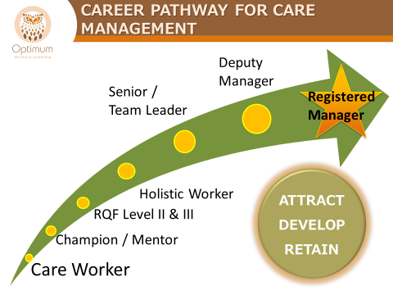
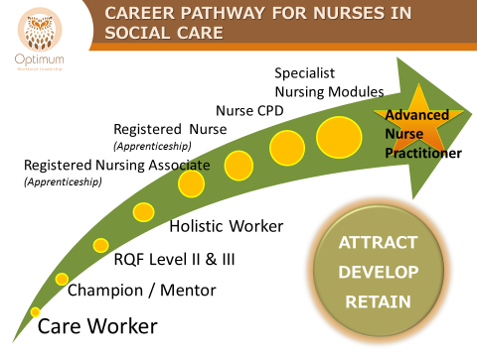
Career Pathways

Slide 28
Future Recruitment Learning
Workshop Development
Content
Other resources

Slide 29
Information Sharing
Partner information
Upcoming events

Slide 30
Information Sharing
An event you have attended recently
Something you have learned recently
Something you would like to know more about

Slide 31
EVALUATION
One thing you are going to do differently?
Tell us how we can improve these events
Other topics for network meetings
OWL services you would like to know more about

