Slide 1
Managers’ Network Meeting Developing a Learning Organisation 23rd May 2019

Slide 2
Key Outcomes:
What makes a Learning Organisation?
Key elements
What L & D resources are available?
Where to access them and how to use them
New resources from Skills for Care
including their NEW L & D Guide
Resources from Optimum
Making use of the career pathways
How to develop your own OWL Champions
Help us to develop new Champion Roles
Information sharing
Notes:
Your networking event so I would like to get an idea of what you are all here for and which of these are a priority for you. This will help to allocate our time this morning effectively.
Make a note of additional outcomes required
Would anyone like to share with us what a learning organisation is to them. There is no right or wrong answer.

Slide 3
What is a Learning Organisation?
A learning organization facilitates the learning of its workforce and continuously transforms itself.
Notes:
A learning organisation model put forward 17 years ago was by someone called Peter Senge. I am not going to go into the detail and if anyone would like to look into it more then it is easy to find through Google. It is however, going through a bit of a revival of interest at the moment as finances become reduced. Implemented well it can reduce external through creating organisational efficiencies by maximising the benefit of learning resources.

Slide 4
Key Elements of a Learning Organisation
Personal Mastery
Skills, enthusiasm for CPD, personal vision
Mental Models
Understanding and defining assumptions
Shared Vision
Commitment to a picture of the future
Team Learning
Learning together supports working together
System Thinking
Understanding of the whole organisation
Notes:
Personal mastery: Individual workers strive to enhance their vision and focus energy on a constant state of learning.
Mental models: Assumptions, generalizations, pictures and images that influence how we understand the world and act, must be recognized and challenged to allow for new ideas and changes.
Building shared vision: Shared vision is a powerful motivator. A leader's vision does not necessarily become shared by those below him. The key here is to pass on a picture of the future. To influence using dialogue, commitment, and enthusiasm, rather than to try to dictate. Storytelling is one possible tool that can be used here.
Team learning: The state where team members think together to achieve common goals. It builds on shared vision, adding the element of collaboration.
System thinking: An understanding of the whole organisation, as well as the components. Key elements are recognizing the complexity of the organization and having a long-term focus

Slide 5
Leadership in a Learning Organisation
The Role of Leadership
Three key leadership roles in the creation of a learning organization:
Leader as Designer: Creating a common vision with shared values and purpose.
Leader as Teacher: The leader as a coach working with mental models present in the organization.
Leader as Steward: The attitude of the leader. The desire to serve the greater purpose of building and reshaping the way business operates.

Slide 6
Learning & Development Resources
https://www.scils.co.uk/
Endorsed Learning Provider Directory.
Find a learning provider
https://www.scie.org.uk/atoz
https://www.nottinghamshire.gov.uk/owl/learning
Notes:
You may have more – please let me know
Flip chart to capture other websites or information

Slide 7
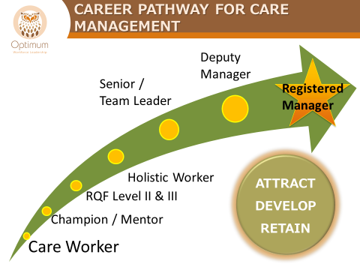
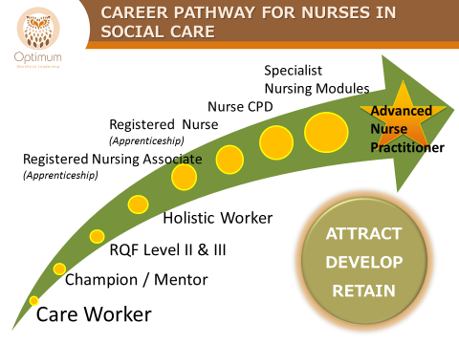
Career Pathways

Slide 8
How will it work?
Champion Programme
The programme has been set up in the following way:-
Learning Agreement:- to be completed and returned with a management commitment and a pledge of how you will support the champion back in the workplace
Pre-course learning conversation:- to be used by the organisation to maximise the outcomes of the training
Champion pledge postcard:- a personal pledge taken from the course to be written by the delegate and returned to the care setting
Notes:
Our vision is to give each person who attends a “champion role” for that subject matter to enable them to feel empowered and that they have a role to play in your care setting.
This only works if as a provider you coach and support the change back in the organisation
6 monthly meetings – action learning
Groups on OWL Facebook
Pledge postcards
Individually designed badges
Certificate of attendance
How do I select a champion?
What values/behaviours do I want to see?
Start to think about learning outcomes as we go through the various topics
Compliment your service with what already exists and the potential to add new champions if that fits.

Slide 9
How will it work?
Champion role
Role modelling and sharing best practice
Challenging current practice
Mentoring and supporting colleagues
Involvement in events and ongoing learning
Celebrating success
Notes:
Our vision is to give each person who attends a “champion role” for that subject matter to enable them to feel empowered and that they have a role to play in your care setting.
This only works if as a provider you coach and support the change back in the organisation
6 monthly meetings – action learning
Groups on OWL Facebook
Pledge postcards
Individually designed badges
Certificate of attendance
How do I select a champion?
What values/behaviours do I want to see?
Start to think about learning outcomes as we go through the various topics
Compliment your service with what already exists and the potential to add new champions if that fits.

Slide 10
Champion Learning Programme
Create your Champions in the following areas:
End of Life
Infection, Prevention & Control
MCA & DoLS
MCA & CDol
Mental Health & Wellbeing
Frailty
Dementia
Trusted Assessor
Follow this link to find out how to book and when these sessions are being run:- https://www.nottinghamshire.gov.uk/owl/news-and-events/events
Notes:
These were the identified subjects that were ranked the highest in terms of priority across all services
Delivered by specialists
Around the county
We envisage the programme to be a continual process where the champions come back together to continue their learning within the topic and use our website to share resources and social media platforms i.e. SLACK and our FB pages to promote further learning within the subject.
Closed FB grps for EOL and IPC

Slide 11
Good news story
A younger adult service that has recently been awarded Outstanding by the CQC.
The organisation have accessed the courses and sent various members of staff to the training and created champions within their organisation.
During their recent visit the CQC inspector was interested in what the staff had learnt and were going to do as “champions” it has been mentioned in their report several times:-
Notes:
Where the above has been done we have seen great changes in practice – which has been recognised by outside organisations

Slide 12
Good news story
Extract from CQC Report:- “The service had staff who were designated 'champions' for dignity, the Mental Capacity Act (MCA) 2005, end of-life care and infection control. These champions continue to play an essential role in developing best practice, sharing learning and acting as role models for other staff. Staff had training from healthcare professionals to understand about health conditions that people lived with. This meant there was an exceptionally strong team of staff who worked at the service”
This shows the benefits and impact that taking the learning, adapting it to your care setting and allowing people the freedom to change practice can bring.
Notes:
Where the above has been done we have seen great changes in practice – which has been recognised by outside organisations

