Slide 1
Five simple steps to prevent and treat pressure ulcers

Slide 2
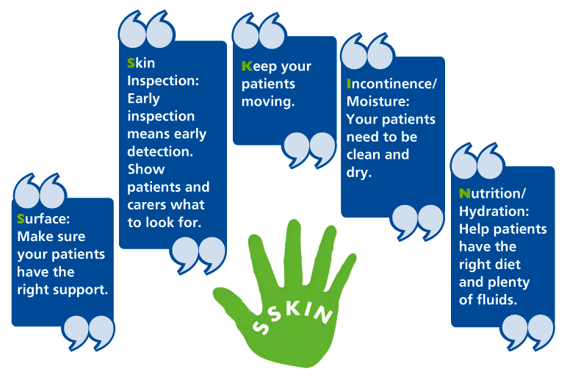
© NHS Midlands and East 2012

Slide 8
© NHS Midlands and East 2012

Slide 9
Scroll and click your way along the Pressure Ulcer Path, using SSKIN.
www.stopthepressure.com
© NHS Midlands and East 2012

