Slide 1
EMAHSN Patient Safety Programme The LPZ Project
East Midlands

Slide 2
Landielijke Pravelentiemeting Zorgproblemen (LPZ)
Once yearly measurement
Single snap-shot
Netherlands, Germany, Austria, Switzerland, Turkey
Care homes can compare their results against:
Previous years results
Other Care Homes
Other Countries
http://www.gb.lpz-um.eu

Slide 3
What does LPZ measure ?
7 common problems that care home residents may face:
Pressure ulceration/ skin damage
Incontinence
Nutrition & hydration problems
Pain
Falls
Restraint
Deterioration

Slide 4
Improving care home patient safety - headlines
450 000 care home residents
Average number of diagnoses – 6.2
Average number of medications – 8 per resident
30% malnourished
56% at risk of malnourishment
Average life expectancy
1 year for nursing homes
2 years for residential homes

Slide 5
Pressure Ulcers Slight reduction in overall data- but significant improvements in some homes individual results

Slide 6
Residents at Risk of Pressure Ulcers Despite increasing number at risk, actual numbers of pressure ulcers hasn’t increased

Slide 7
Falls within the last 12 months

Slide 8
Pressure Ulcer Data

Slide 9
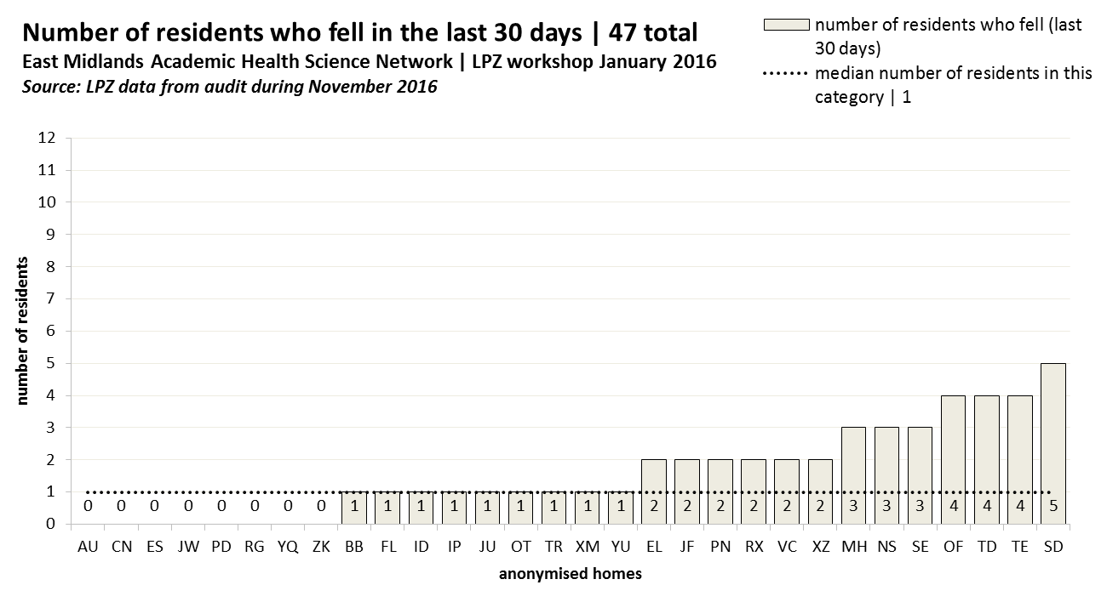

Slide 10
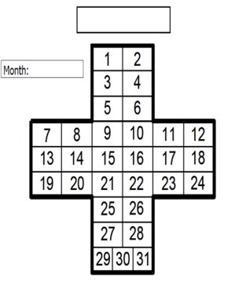
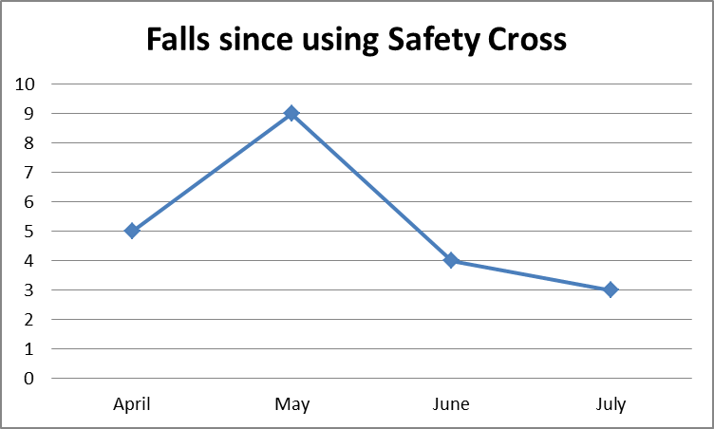
Beechdale Care Home
How has this helped?
It has raised awareness for all staff, as the cross is displayed in the staff room and the results can be seen at a glance each month by all staff
It has led us to increase our knowledge and vigilance around falls and any themes and trends such as where and when the falls occur
Staff now have the confidence to pass on any concerns regarding falls, what may cause a fall and any hazards, so that we can take more pro-active steps to prevent?
“The LPZ gives us more knowledge about common care problems that our residents are at risk of and it is a great way of updating training for our staff, having knowledge in areas that we are unsure about. The events give you time to discuss with others what they do, and share experiences, and the meetings are relaxed and friendly. Each person with something to ask or say is listened to and supported”

Slide 11
How has LPZ helped Oakdene Care home?
Increased nutrition and hydration of residents
Improved staff awareness
LPZ award for the care home in 2017
Improved CQC rating

Slide 12
What LPZ offers Care Homes
Free training events and resources around key audit areas
Individualised support
Opportunity to demonstrate to regulators e.g. CQC commitment to improving quality
Confidence building for Managers and Staff
Opportunity to compare your home against others
Opportunities to share ideas with other care homes
“Since they looked at why I was falling, I have changed rooms and feel safer. I am sleeping and eating better, and I feel much brighter in the day” Mary
Care Home Resident
“Following our attendance at the L.P.Z. meetings we were inspired and motivated to re-evaluate our approach to several aspects of our care, the effectiveness of our assessment tools and how to improve our service. L.P.Z. enabled us to meet with other professionals and take advantage of extra training opportunities for our staff.” Care Home Manager
Care Home Manager
Care Home Manager
“I am now happy to stand up at conferences and share with others our experience of LPZ, which is something I never dreamed I’d do”

