Slide 1
How to recruit great care staff using your local connections
Neil Eastwood
Author,
Saving Social Care
@StickyNeil

Slide 2
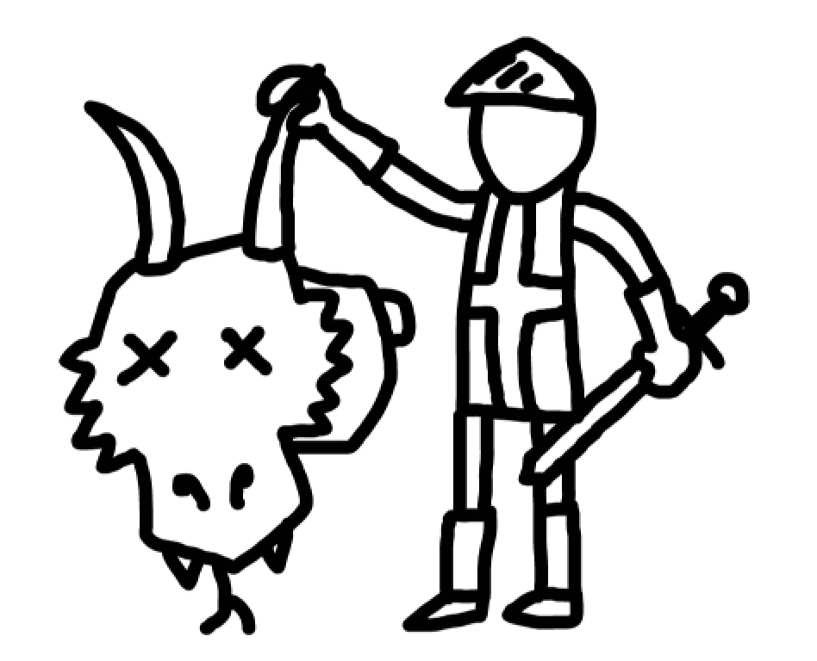
3 Key Outcomes:
Who to look for
How to use your connections to find great new staff
Stopping no-shows

Slide 3
Are you laser-focused on WHO you want?
HINT:
It’s not just the one that actually turned up to the interview

Slide 4
Cloning Experiment
Average Cloner Age:
51 versus national average of 43

Slide 5
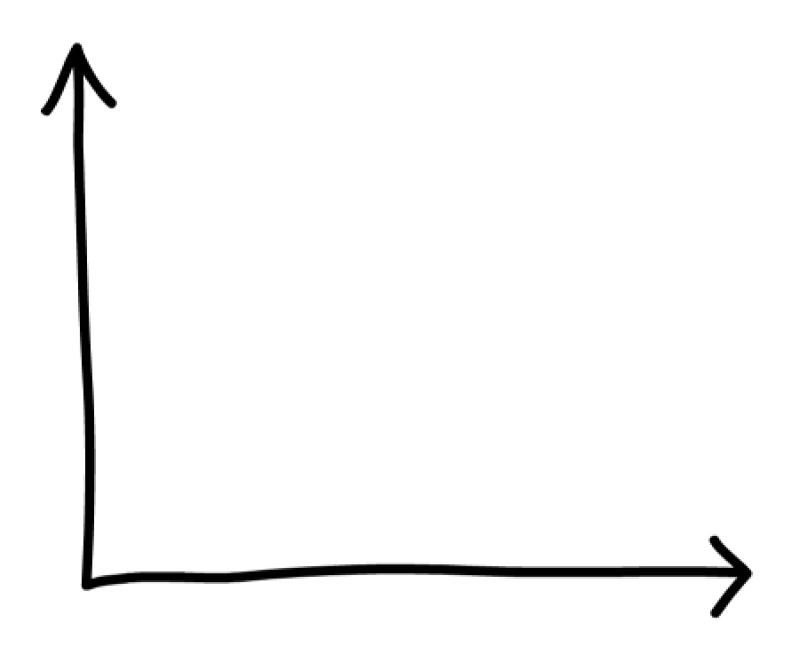
Care Worker Age range
Avg age: 43
Clone age: 51
No. of staff

Slide 6
Still in post
60 yr olds avg 4 yrs service
43 yr olds avg 2.5 yrs service
4yrs
3yrs
2yrs
1yr

Slide 7
Cloning experiment
Why paid care appeals:
55% had cared for a loved one
How had they heard of your care org:
46% word of mouth or referral

Slide 8
Personal connections REALLY matter to find the best care staff

Slide 9
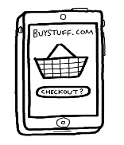
Online recruitment is biased to youth
18-24
25-34
35-44
45-54
55-64
65+

Slide 10
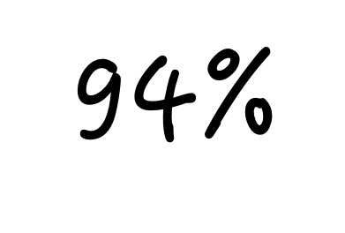
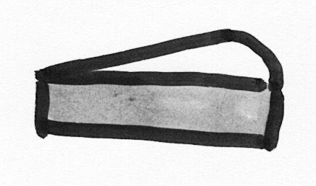
Where are applicants coming from?
Notes:
Examples of how data can help us

Slide 11
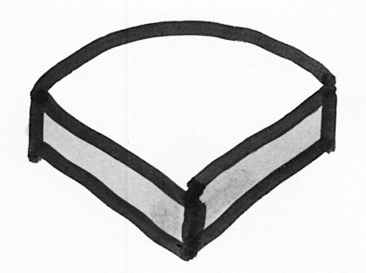
Where do starters come from?

Slide 12
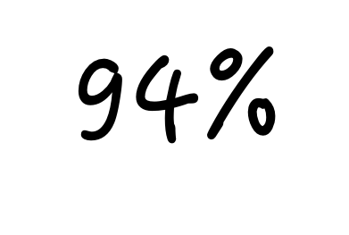
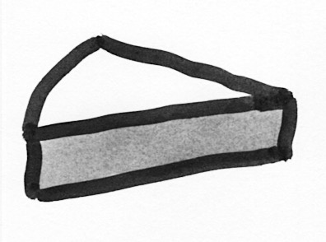
Who stayed 12 months?
Notes:
The true measure of recruitment effectiveness…

Slide 13
Refer-a-friend is the most powerful source of quality care staff Worldwide

Slide 14
Why?

Slide 15
Target: 25-35% of new starters from this source

Slide 16
Stalk your Good Leavers
Notes:
Thanking past employees for being part of a success story

Slide 17
Ask Interviewees

Slide 18
Care connection
Word of mouth
Partner orgs
Family Carers
Faith-based
Cause-related
Strong connection
Ex-employees
Applicants
Suppliers
Deep connection
Refer-a-friend
Clients’ families
Board/Trustees

Slide 19
Did I apply to you?
What is the job again?
I will definitely be there on Tuesday at 2

Slide 20
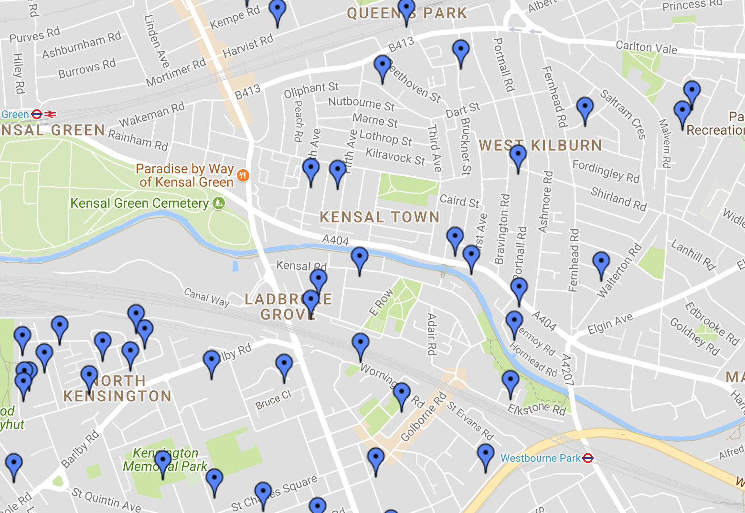

Slide 21
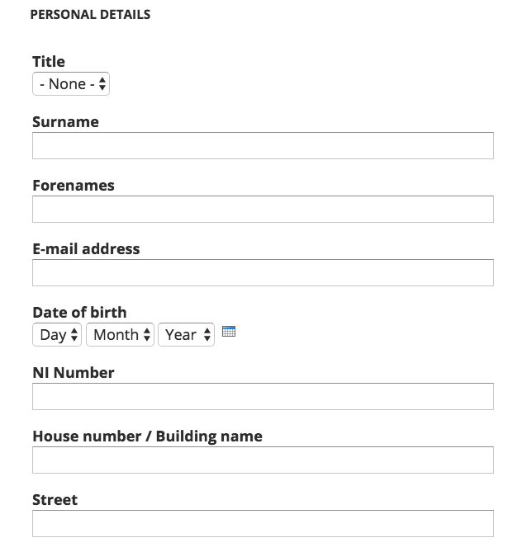

Slide 22
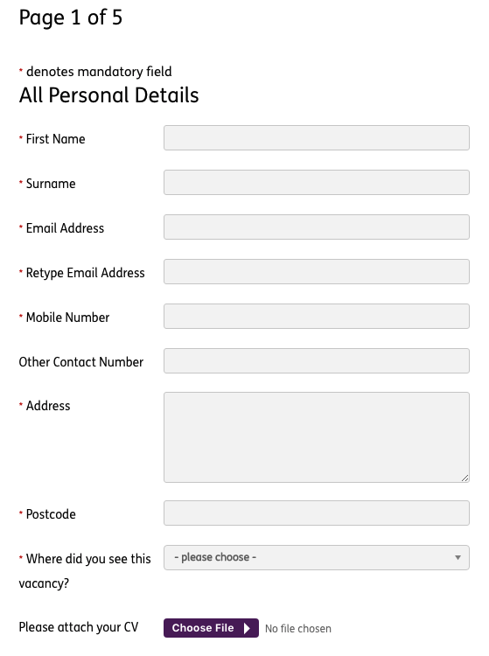

Slide 23
My Recruitment Sourcing Strategy
Job boards
Community Outreach and word of mouth
Facebook
Employee and network connections

Slide 24
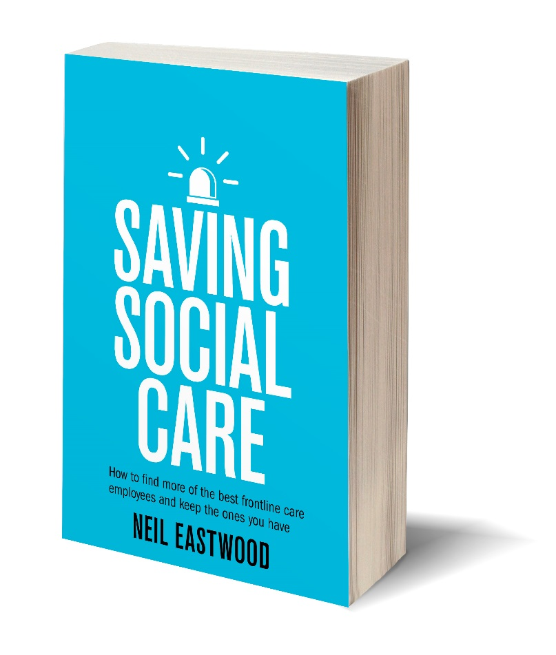
“I am impressed by both the content and style of Neil’s book”
Sir David Behan CBE,
Chief Executive CQC
Sign up for a year’s worth of free recruitment tips and buy a signed book…
@StickyNeil

