Slide 1
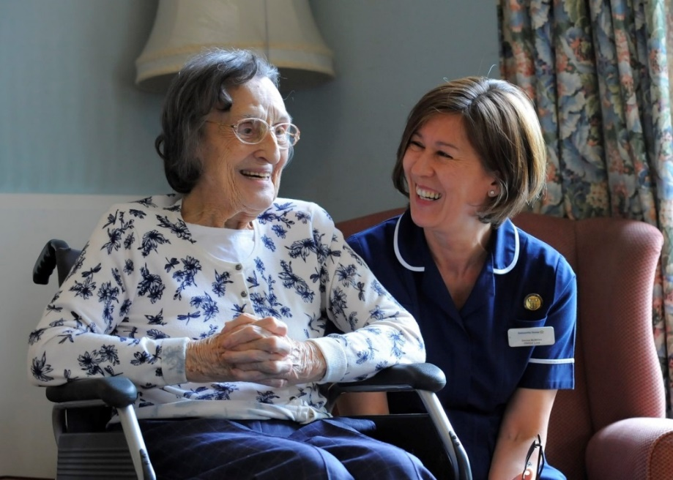
Working with partners for quality improvement
Presenters – Lindsay Furze and Catriona Eglinton
Event – Optimum Annual Conference
Date – 19 March 2019
1
Notes:
1

Slide 2
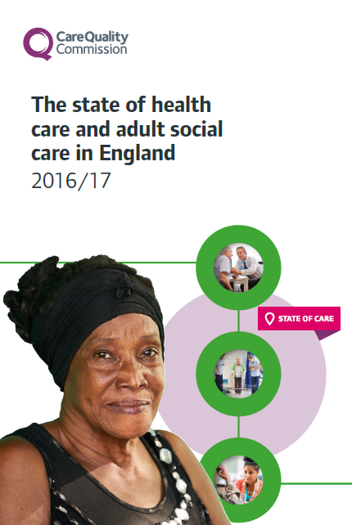
Our purpose and role
We make sure health and social care services provide people with safe, effective, compassionate, high-quality care and we encourage care services to improve
Register
Monitor and inspect
Use legal powers
Speak independently
Encourage improvement
People have a right to expect safe, good care from their health and social care services
Notes:
Today I want to update you on 4 areas
State of care
Quality matters
Local system reviews
Next phase
Our purpose remains the same – our focus and drive behind all that we do.

Slide 3
Our inspection process
The methodology for inspections remains the same
We inspect based upon the Key Lines of Enquiry (KLOE). There were some changes to the KLOEs and ratings characteristics in 2017 and 2018
We look for good

Slide 4
We are moving towards paperless inspections, many inspectors will be taking notes on laptops and we may also take photographs of documents, equipment or the environment Full feedback will be given at end of inspection. A written or electronic copy will be provided. This may be shared with stakeholders.

Slide 5
Inspections for services already rated as good and outstanding, will be more focused on what we observe and what people tell us The purpose of these inspections is to re-affirm the rating Where we find information to suggest an improvement in rating or evidence of a decline in quality we will follow this up All outstanding reports go to a regional panel. Particular scrutiny is given to services that have increased more than one rating
Our inspection process

Slide 6
A new report template is now in use. This is shorter and more accessible. This has been created in collaboration with providers and stakeholders The report is now structured around a standard template of sub-headings and bullet points which correspond with the KLOEs The way we gather evidence is the same, but there will not be as much detail or repetition Providers will be offered the opportunity to have a discussion about the report with the lead inspector within two to four days of receiving the draft report. The purpose will be to clarify any aspects of the draft report This does not affect the factual accuracy process
Changes to reporting

Slide 7
Be inspection ready at all times – we want to see how the service normally runs Reassure your staff, tell us if there is anything we can do to put your staff at ease Ensure you are familiar with the KLOEs Record any examples of good practice so that you can share these on inspection Remember… we are looking for evidence of impact upon people
Preparing for inspection

Slide 8
Formal contact with CQC
Statutory notifications
Notifications are vital to inform our risk monitoring
Providers have a legal duty to notify us of key events and failing to notify is a potential offense and a rating limiter on inspection reports
Notifications should be completed as thoroughly as possible, including detail of what was in place before, during and after any incident
If you are unsure how/what to notify please do talk to us
The Provider Information Return: The development work on this this has been paused.
Registration changes: These are normally managed by our registration team – the best place for advice is our national contact centre

Slide 9
Informal contact with CQC
We encourage providers and managers to contact us if they have questions
If you would like to update us about changes to your service then please do (for example: the registered manager is away for a short period and you are providing us with an alternative contact)
If you would like to update us regarding general intelligence about your service, this is also really helpful. For example, a disgruntled ex-employee who has threatened to report concerns
Please direct all informal enquiries to our national contact centre. They will record it and ensure it is passed to the correct inspector

Slide 10
Keep up to date
Subscribe to receive our monthly bulletin: http://www.cqc.org.uk/content/get-our-newsletter
Follow us on Twitter:
@CQCProf
Join our provider online community to share your views: www.cqc.org.uk/organisations-we-regulate/get-involved/join-our-online-communities-providers

Slide 11
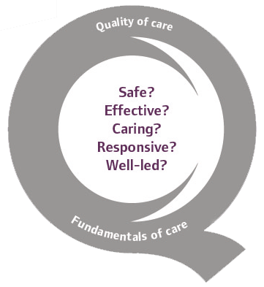
Thank you
www.cqc.org.uk
enquiries@cqc.org.uk
@CareQualityComm

