Slide 2
Internal Audit Optimum Members’ Facilitated Workshop 20th October2017

Slide 3
WELCOME & HOUSEKEEPING
Fire alarms
Toilets
Mobile phones
Evaluations

Slide 4
OUTCOMES for the Session
By the end of the Workshop you will:
Have a clear idea of what an audit system is and yours could look like
Have identified what you need to measure and how
Have shared you existing good practice
Have links to some internal audit resources
Have addressed some of the challenges identified.

Slide 5
INTRODUCTIONS
Working as a table, introduce yourselves to the rest of the group:
Who you are
Which organisation
Who your clients are
What you are hoping to get out of today
Notes:
Capture the expectations on flip

Slide 6
What is an internal audit system?
Describe what it is?
Why is it important?
Notes:
Capture on flip charts

Slide 7
What is an internal audit system?
DEFINITION of 'Internal Audit‘
The examination, monitoring and analysis of activities related to a company's operation, including its business structure, employee behaviour and information systems.
Notes:
Couple of definintions

Slide 8
What is an internal audit system?
Internal auditing
An independent, objective assurance and consulting activity designed to add value and improve an organization's operations. It helps an organization accomplish its objectives by bringing a systematic, disciplined approach to evaluate and improve the effectiveness of risk management, control and governance processes.

Slide 9
What is an internal audit system?
As a table, consider:
What you measure currently?
How do you measure it?
Qualitative?
Quantitative?
Baseline?
Notes:
Table top working and capture thoughts
Divide flipchart paper in half and on one side write the what,

Slide 10
What is an internal audit system?
As a table, consider:
What do you do with the information?
How do you share it and with whom?
Narrative
Pictorial
Notes:
Table top working and capture thoughts
Divide flipchart paper in half and on one side write the what and the other side the how and who

Slide 11
Qualitative measurement
Methods:
How do you measure?
Notes:
Refer to business plan template for qualitative baselining
Refer to the ongoing development section.

Slide 12
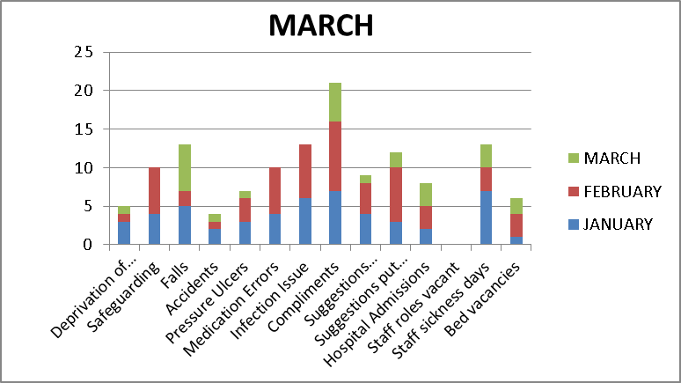
Quantitative measurement
Methods:
How do you measure?
Notes:
Where the data you are collecting is quantitative there are more opportunities for visual display
It also helps to bring home the fact – what happens next?
This template will be sent to you

Slide 13
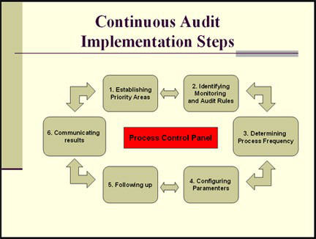
What is an internal audit system?
Notes:
This puts the process in to context.
How are we doing so far – ask for observations

Slide 14
What are you audited on/against?
THEN as a table group discussion
Consider:
If you get this process right for you, how will this help you?
CQC
NCC
CCG
Other audits
Notes:
Give out the audit framework

Slide 15
What are you audited on/against?
THEN as a table group discussion
Consider:
What you currently audit and have identified and which of the audits they would support

Slide 16
What are you audited on/against?
CQC
Key lines of enquiry, prompts and ratings characteristics for adult social care services

Slide 17
What are you audited on/against?
NCC
Quality Audit Framework
Standards of Care

Slide 18
RESOURCES
CQC - Employer guidance
https://www.cqc.org.uk/sites/default/files/20170609_Adult-social-care-KLOEs-prompts-and-characteristics-FINAL_2.pdf
Nottinghamshire County Council
Quality Audit Framework – Copies on table

Slide 19
RESOURCES
Optimum Workforce Leadership - Business pages http://www.nottinghamshire.gov.uk/owl/business/meeting-your-responsibilities
Also OWL competence tools provide evidence eg:
Competence frameworks
Grey Matters assessment licences
Skills for Care – Leadership and Management
http://www.skillsforcare.org.uk/Leadership-management/Leadership-and-management.aspx

Slide 20
EVALUATION and GOOD PRACTICE
Looking at the information and resources that you have found out about today:
What actions are you going to take away from this?
How can we share good practice?

Slide 21
FEEDBACK AND NEXT STEPS
EVALUATION FORM
Please complete the evaluation form before you leave
LET US KNOW:
Was the format of today’s workshop useful?
What other topics would you like to see included?

Slide 22
OPTIMUM MEMBERS WORKSHOP
THANK YOU

